Slide 1
SCHOOL MANAGEMENT SYSTEM

Slide 2
LORD OF THE CODES
Team Members:
Aduri Ajay
Binsu Susan Thomas
Parvathy Balachandran
Sam Issac
Santhosh Hazare
Vignesh Karthigeyan

Slide 3
SCHOOL MANAGEMENT SYSTEM
It contains
Home page
Academic Information page
About us page
Contact us page
Event page

Slide 4
Tech Stack
Frontend – React
Backend – Node Js
Database - MongoDB

Slide 5
SCHOOL MANAGEMENT SYSTEM
Academic page contains
Admission Form
Staff information
Student information

Slide 6
SCHOOL MANAGEMENT SYSTEM
Admission information form contains below fields
Student name
Guardian Name
Age
Contact details
Address
Class
Admission Date
Date-Of –Birth
Type
Previous school
Gender
Id Proof
Blood Group
Fee

Slide 7
SCHOOL MANAGEMENT SYSTEM
Staff Information
Faculty name
Subject
contact details
Qualification
Address

Slide 8
SCHOOL MANAGEMENT SYSTEM
Student Information
Student Name
Guardian Name
Class
Section
Gender
Blood Group
Emergency contact number
Date of birth
Year of Admission
Admission Number
Address

Slide 9
Entities- Tables & Structure
Students
Faculties
Admissions

Slide 10
Student Table
Id
Name
Class
Section
Gender
Blood group
DOB
Admission number
Address
Guardian name
Contact number

Slide 11
Admission Table
Id
Fee
Student Name
Guardian name
Admission date
DOB
Type
Previous School
Blood group
Identity- Proof number
Contact Number
Gender

Slide 12
Faculty Table
Id
Name
Subject
Address
Qualification
Contact Number

Slide 13
UI
Home Page
Academic information
Admission form link
Faculty Information
Student Information
Contact page
Contact Number
Email
Address

Slide 14
UI
Event Page
School Anniversary
Sports events
Food fest
Art fest
Exhibition and Workshops

Slide 15
UI
About us Page
Details of Institution
Vision & Mission
History
Emblem

Slide 16
Home Page demo
Demo of Home page
Navigation to other pages are provided,
Also a included tab to read more about the School

Slide 17
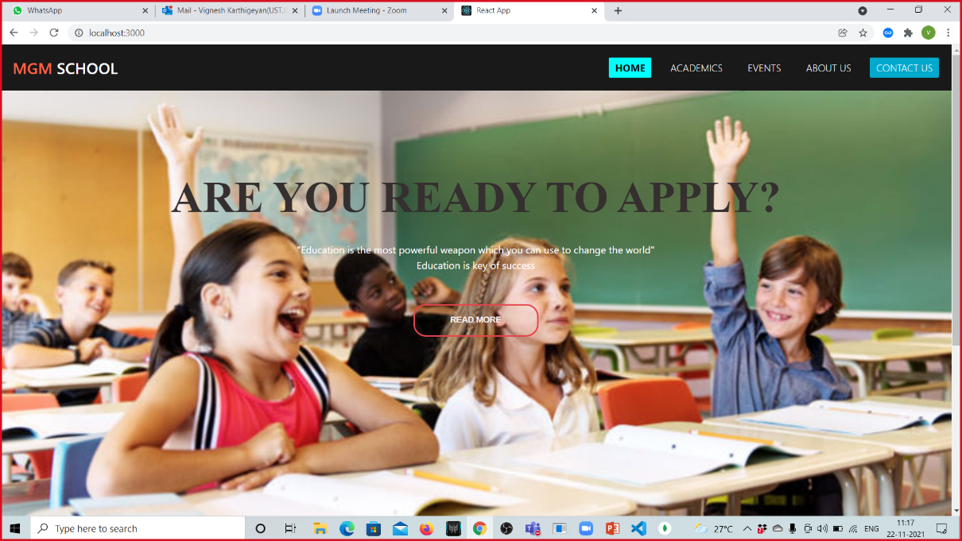

Slide 18
Admission Form demo
Form and it’s labels
Provided with input type text boxes

Slide 19
Contact Us Display
Contact us form provided with Contact details such as Contact number, Email, and Address

Slide 20
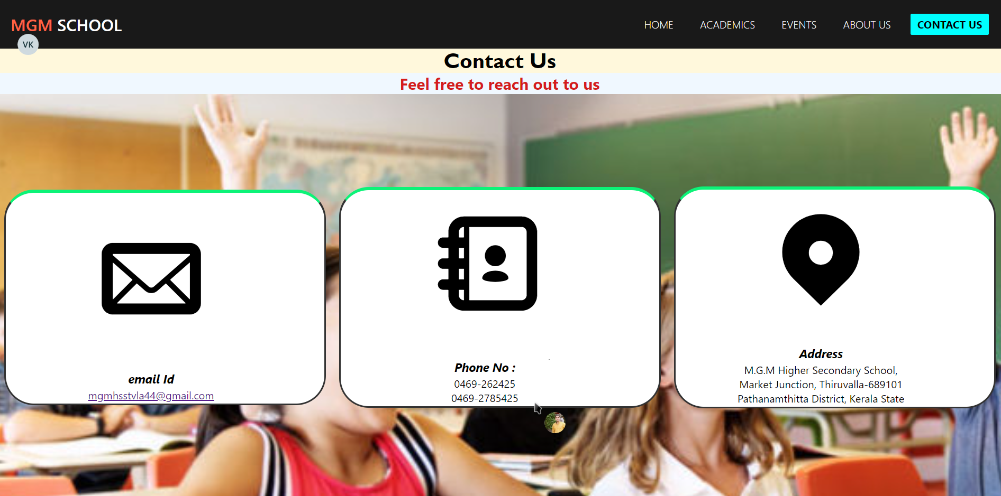
Contact Us Page

Slide 21
Tools Used:
Reactjs (Front end)
Nodejs (Back end)
Expressjs (Back end)
Mongodb (Data base[DB])
Cascading Style Sheets –CSS (Front end)

Slide 22
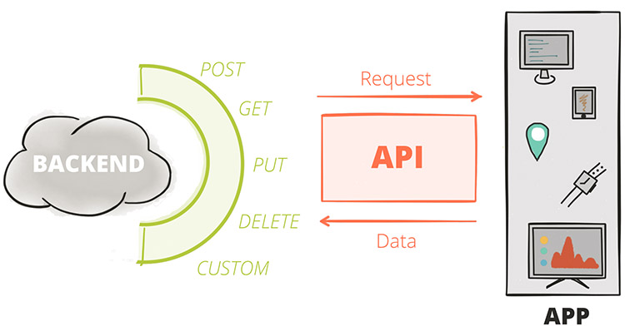
Working Of the App

Slide 23
Admission Page
Displays some information regarding the admission procedure,
And the student, faculty details., etc

Slide 24
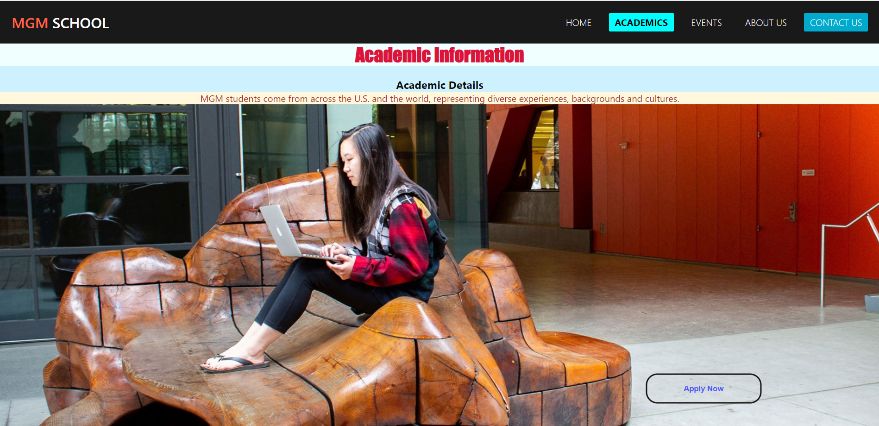
Admission Page display

Slide 25
Admission Form Page
Displays the field text boxes to collect information of user who wishes to apply for the school.,

Slide 26
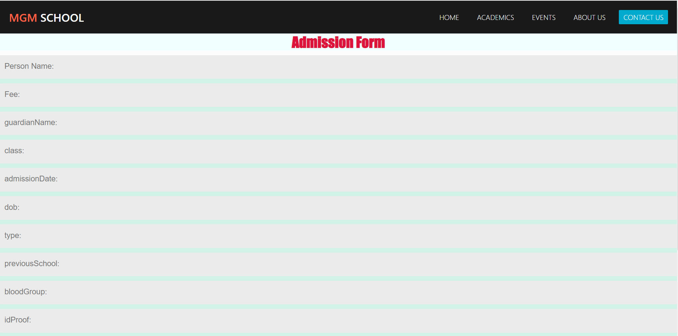
Admission Form Page

Slide 27
Student Table display
When the student inputs the login details to the form,
The api will carry the info to the backend and get the, required/necessary details of particular student.

Slide 28
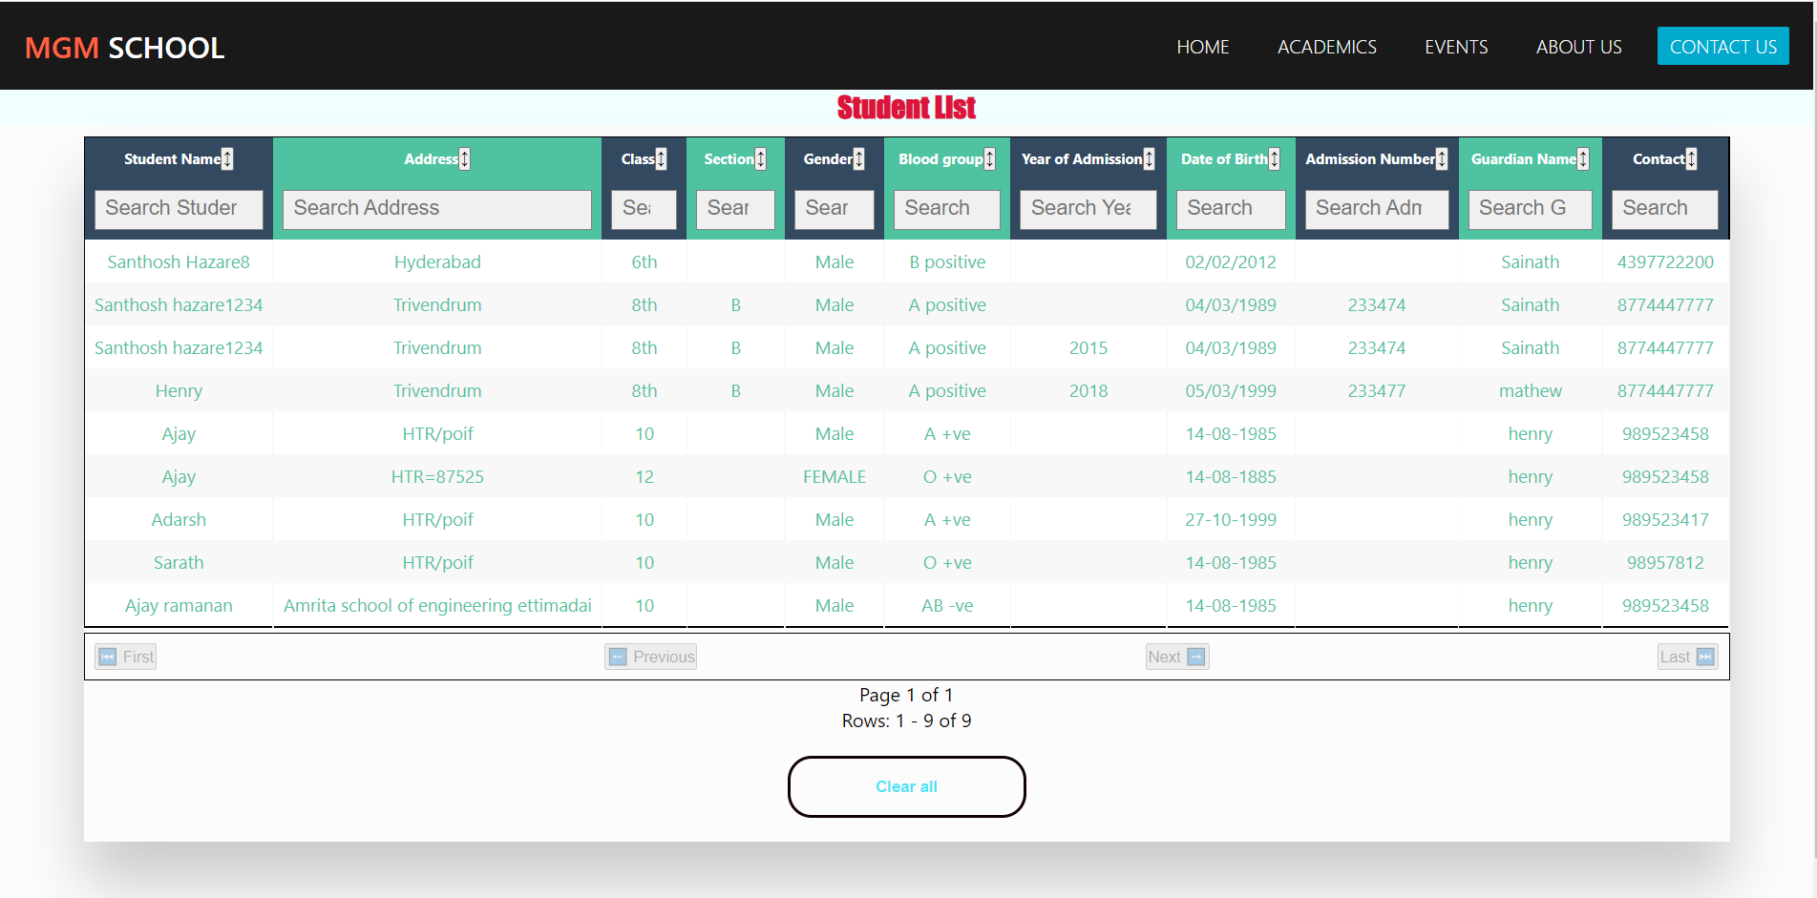
Student Table

Slide 29
Faculty Table Display
When a faculty inputs his login details to the form,
From the backend database he’ll be able to get the required info like Id, Name, subject.,

Slide 30
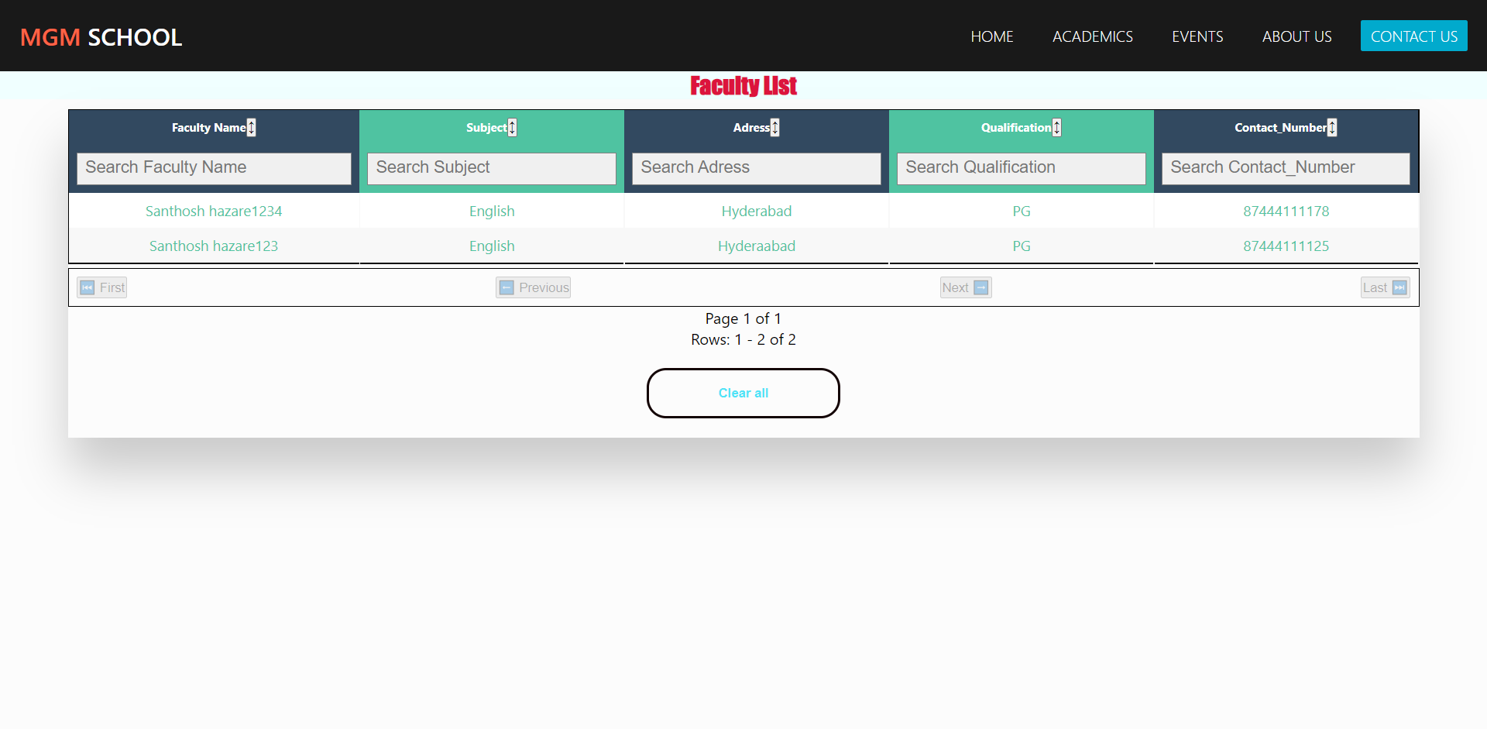
Faculty Table Page

Slide 31
Event page display
The event page will have the latest activities that happened like,
School anniversary, sports events, food fest etc.,

Slide 32
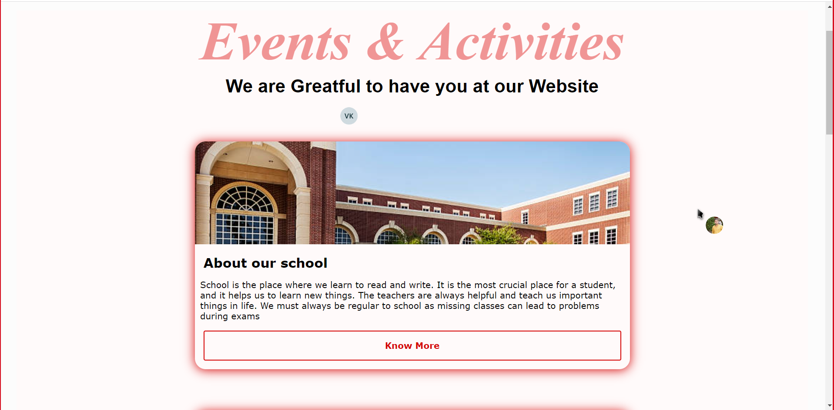
Event Page

Slide 33
About Us page
Displays basic information about the school and different types of achievements, honors which they’ve received through years.

Slide 34

About us Page

